Slide 1

Sentiment Analysis of ChatGPT
Presented By ~ BOWTHIRAN

Slide 2
What This Project Does
This project focuses on analyzing user feedback about ChatGPT across different platforms. It includes sentiment classification (Positive, Negative, Neutral), rating distributions, trend analysis over time, and comparisons across various sources. Additionally, a pre-trained model is used to predict user input sentiment, enhancing automated analysis and accuracy.

Slide 3
business problems
Too much customer feedback (reviews, surveys, comments) to read and understand manually.
ChatGPT can generate confident but Risk of business contexts (healthcare, finance).
ChatGPT doesn’t know real-time data or events unless integrated with external tools.
Decision-making is delayed or based on incomplete data.

Slide 4
Proposed solution
Use NLP models to automatically classify text data.
Understand customer opinions to improve product features.
Apply sentiment analysis to understand customer emotions at scale.
Visualize insights from text data using dashboards and reports.
Develop better engagement strategies based on sentiment insights.
Identify areas for improvement based on negative and neutral reviews.

Slide 5
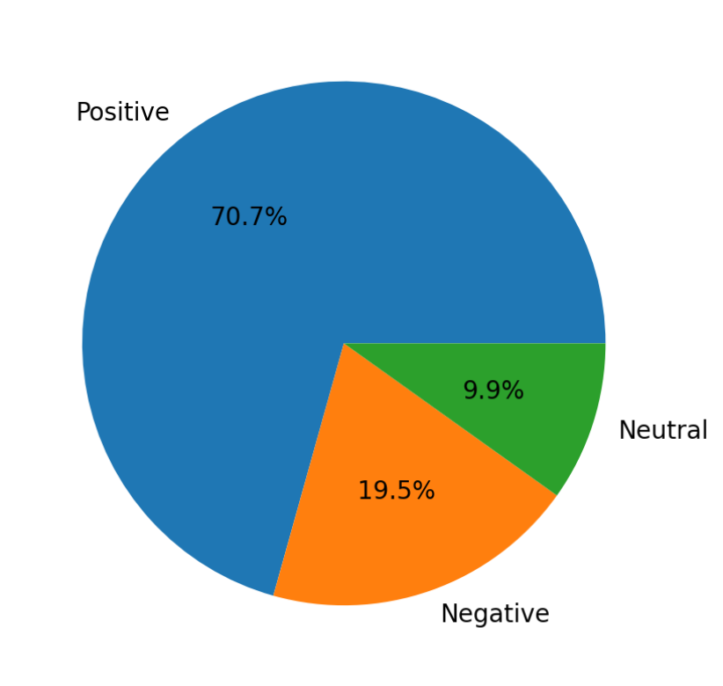
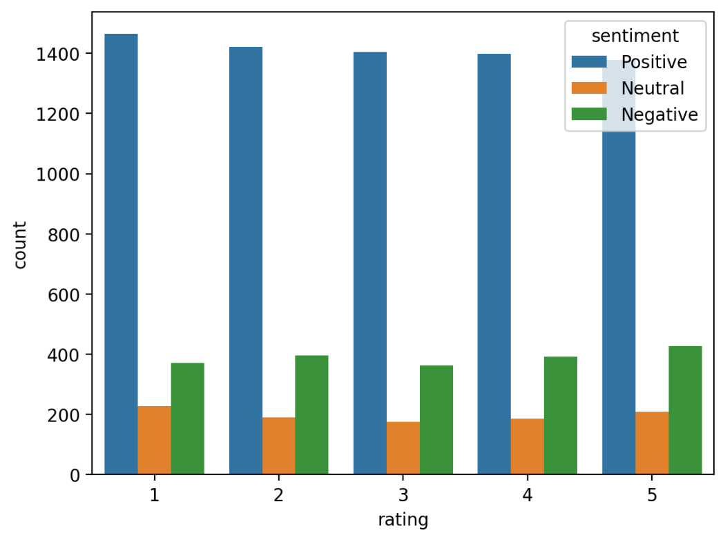
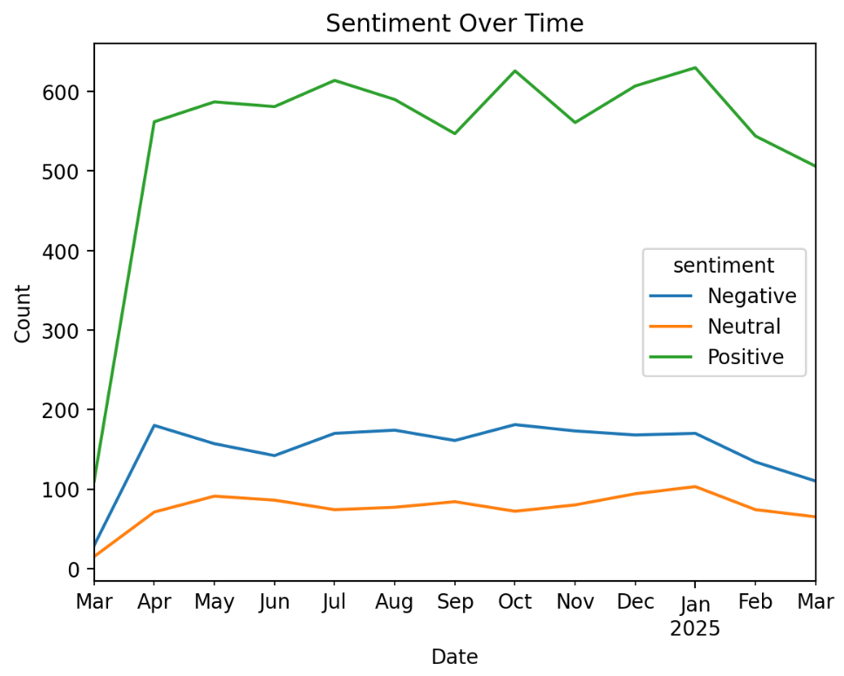
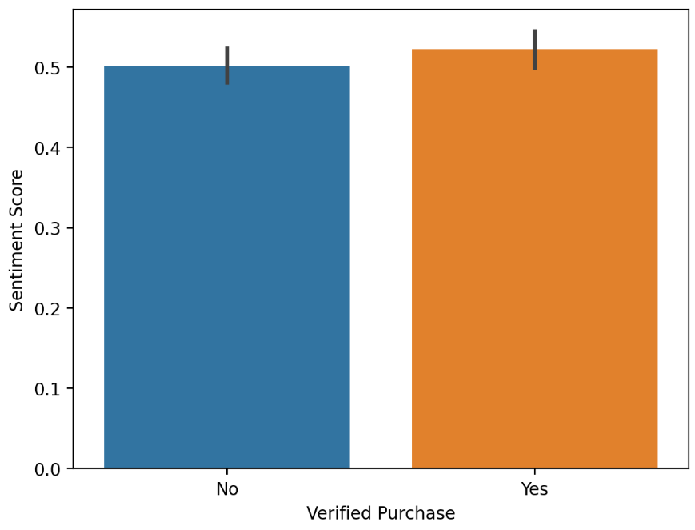

Slide 6
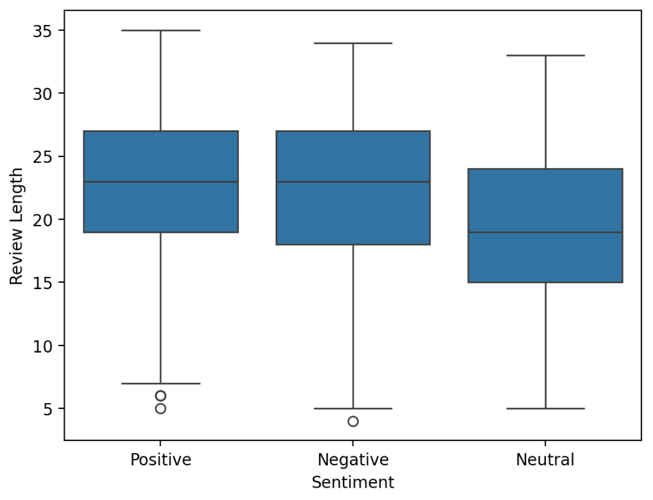
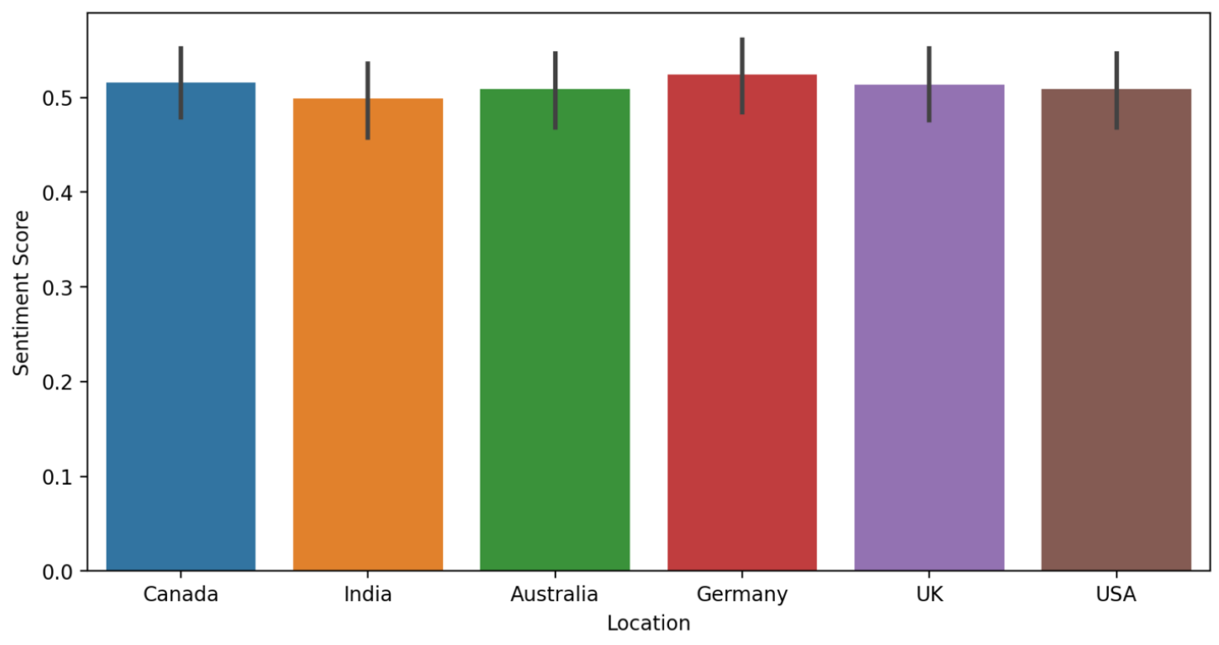
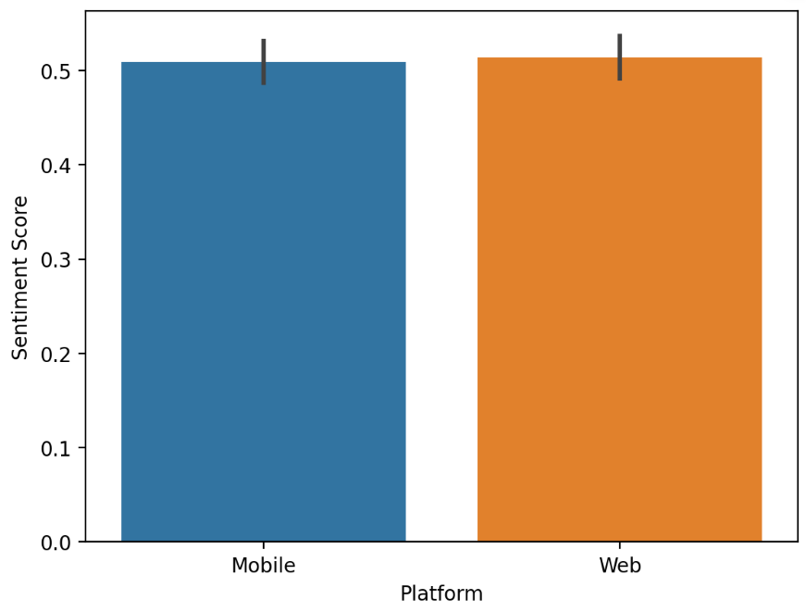
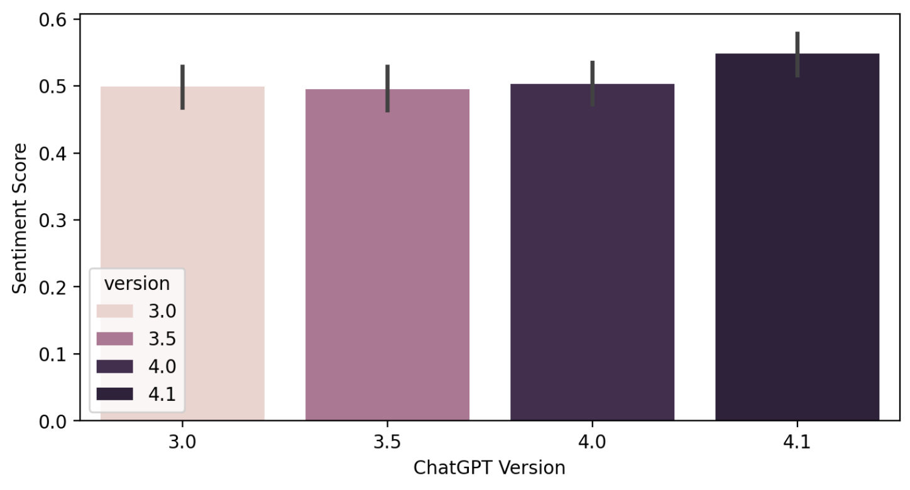

Slide 7
Insights :-
In overall 70.7% positive reviews, negative have 19.5 & neutral have 9.9
All rating have the same negative comments. Longer reviews are more likely to contain negative or mixed sentiments, while short reviews are mostly positive
March 2024 to March 2025 which indicate the high positive reviews.
Germany, Canada & UK have higher ratings compared to other regions.
Both users are widely using ChatGPT, but Web users are slightly higher compared to Mobile users.
ChatGPT 4.1 and 4.0 have relatively higher sentiment scores compared to earlier versions.

